Slide 1
CYB 307: Information Security Engineering
Ageebee Silas FAKI PhD
faki.silas@binghamuni.edu.ng
+2348066239099

Slide 2
Introduction
Security engineering is the practice of designing and implementing secure information systems to protect the confidentiality, integrity, and availability of the systems.
It involves integrating security controls into the system design, such as secure defaults, encryption, and physical security measures.
The objective is to ensure that the systems can operate effectively even in the face of anomalous and disruptive events, including those caused by misuse and malicious behavior.

Slide 3
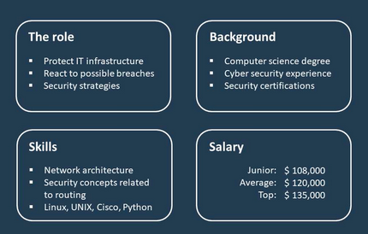
Information Security and General Roles
Information security, often abbreviated (InfoSec), is a set of security procedures and tools that broadly protect sensitive enterprise information from misuse, unauthorized access, disruption, or destruction.
InfoSec encompasses
physical and environmental security,
Access Control

Slide 4

Security engineering is the process of incorporating security controls into the information system so that they become an integral part of the system’s operational capabilities

Slide 5
Jobs Roles
Information Security Manager/Specialist
Information Security Auditor
Risk/Vulnerability Analyst/Manager
Information Security Analyst
Penetration Tester
Security Architect
Computer Network Defender
Cybersecurity Defense Analyst
Information Security (IS) Director
Information Assurance (IA) Program Manager
Network Operations Specialist
System Administrator
Systems Security Analyst
Cyber Defense Analyst
Cyber Defense Infrastructure Support Specialist
Vulnerability Assessment Analyst
Warning Analyst
Exploitation Analyst
All-Source Analyst
Mission Assessment Specialist

Slide 6
IT Project Manager
Application Security Engineer/Manager
Enterprise Architect
Security Architect
Research & Development Specialist
Systems Requirements Planner
System Testing and Evaluation Specialist
Information Systems Security Developer
Systems Developer
Technical Support Specialist
Target Developer
Target Network Analyst
Multi-Disciplined Language Analyst
All Source-Collection Manager
All Source-Collection Requirements Manager
Cyber Intel Planner
Cyber Ops Planner
Partner Integration Planner
Cyber Operator
Chief Information Security Officer
Information Security Officer
Chief Security Officer
Information Assurance Security Officer

Slide 7
Framework of Security Engineering
Good security engineering requires four interactive elements
There's policy: what you're supposed to achieve.
Mechanism: the machinery assembled in order to implement the policies. Examples are ciphers, access controls, hardware tamper resistance
Assurance: the amount of reliance you can place on each particular mechanism.
Incentive: the motive that the people guarding and maintaining the system have to do their job properly, and also the motive that the attackers have to try to defeat your policy.

Slide 8
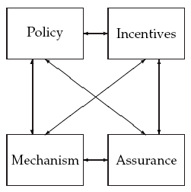
Security Framework in Diagram

Slide 9
Example of Security Application in a Bank
The core of a bank's operations is usually a database system.
Threat is on Staff:
Every staff must log out before closing policy
Staff use tokens for confirmation –mechanism
The token protects the bank from being hacked →incentive
Every staff has a strong password →Assurance
Threat to bank website:
website install SSL/TLS →mechanism
password for customers →mechanism
Password protect customers from been hacked → incentives
Running password, token and security password →Assurance

Slide 10
Information Security Model
Confidentiality: Confidentiality refers to protecting the data from unauthorized access.
Integrity: Checks whether the information present is in the correct format or not.
Availability: information should be accessible to its authorized users at all times needed.
Confidentiality
Integrity
Information Security
Availability

Slide 11
Information Security Requirements
Security requirements can be formulated on different abstraction levels. At the highest abstraction level they basically just reflect security objectives.
System designer suggests distinguishing 4 different security requirement types:
Secure Functional Requirements, this is a security related description that is integrated into each functional requirement. Typically this also says what shall not happen. This requirement artifact can for example be derived from misuse cases

Slide 12
Functional Security Requirements, these are security services that needs to be achieved by the system under inspection. Examples could be authentication, authorization, backup, server-clustering, etc. This requirement artifact can be derived from best practices, policies, and regulations.
Non-Functional Security Requirements, these are security-related architectural requirements, like "robustness" or "minimal performance and scalability". This requirement type is typically derived from architectural principles and good practice standards
Secure Development Requirements, these requirements describe required activities during system development which assure that the outcome is not subject to vulnerabilities. Examples could be "data classification", "coding guidelines" or "test methodology

Slide 13
Security Development Life Cycle (SecSDLC)
The SecDLC introduces security and privacy considerations throughout all phases of the development process, helping developers build
highly secure software,
address security compliance requirements,
and reduce development costs.
The security development system keeps upgrading with new scenarios in response to emerging technologies like the cloud, the Internet of Things (IoT), and artificial intelligence (AI).

Slide 14
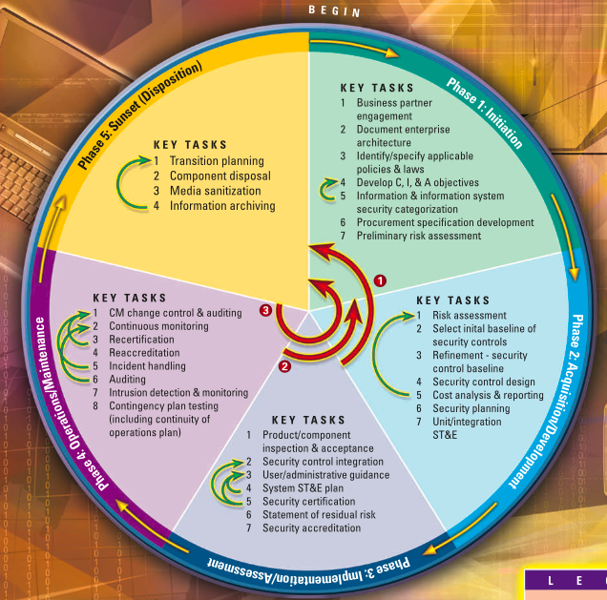
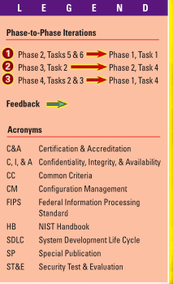
National Institute of Standard and Technology Model

Slide 15
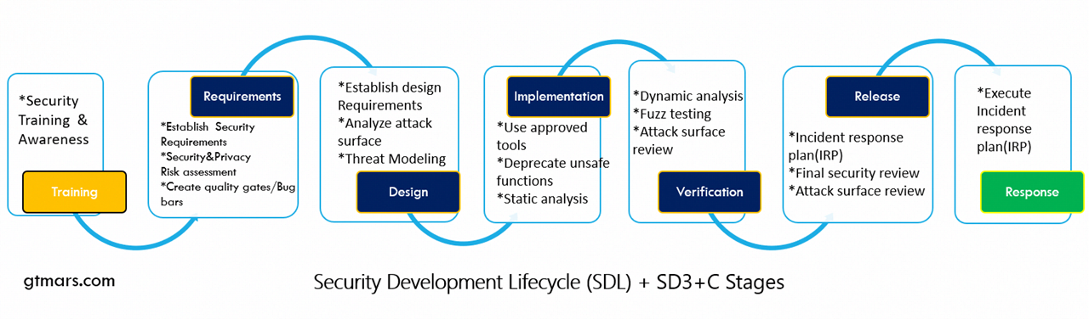
Microsoft Model

Slide 16
Benefits of SecDLC
Class Discussion

Slide 17
